Slide 1

COMPUTER NETWORKS
(BCSC 0008)
Copyright content, use only with the written permission of presenter mentioned
Lecture 21

Slide 2
Text and Reference Books
Text Books:
Fourouzan B. A. (2004), “Data Communication and Networking”, 4th Edition, McGraw-Hill.
References:
Kurose, J. F. and Ross K. W. (2005), “Computer Networking: A Top-Down Approach Featuring the Internet”, 3rd Edition, Addison-Wesley.
A. S. Tanenbaum (2006), “Computer Networks”, 2nd Edition, Prentice Hall India.

Slide 3
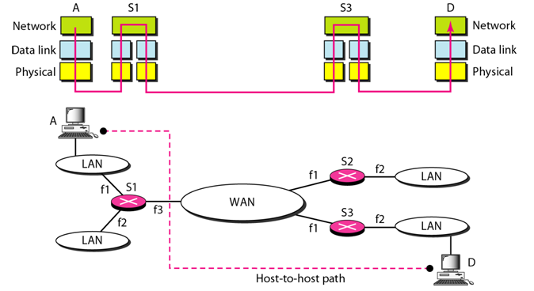
Transmission using Network Layer

Slide 4
Network Layer
Services:
  Routing and Forwarding
  Host to Host Delivery (Using IP Addressing)
transport segment from sending to receiving host
on sending side encapsulates segments into datagrams
on receiving side, delivers segments to transport layer
network layer protocols in every host, router
router examines header fields in all IP datagrams passing through it

Slide 5
Two key network-layer functions
forwarding: move packets from router’s input to appropriate router output
routing: determine route taken by packets from source to dest.
  routing algorithms
analogy:
routing: process of planning trip from source to dest
forwarding: process of getting through single interchange

Slide 6
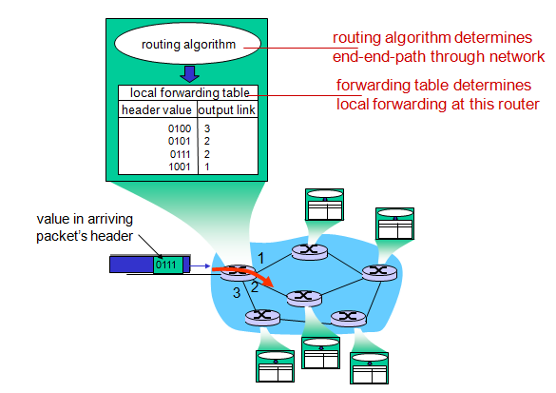
Interplay between routing and forwarding

Slide 7
Some basics of IP
The term internet is short for “internetworking”
  interconnection of networks with different network access mechanisms, addressing, different routing techniques, etc.
An internet
  Collection of communications networks interconnected by layer 3 switches and/or routers
The Internet - note the uppercase I
  The global collection of individual machines and networks
IP (Internet Protocol)
  most widely used internetworking protocol
  foundation of all internet-based applications

Slide 8
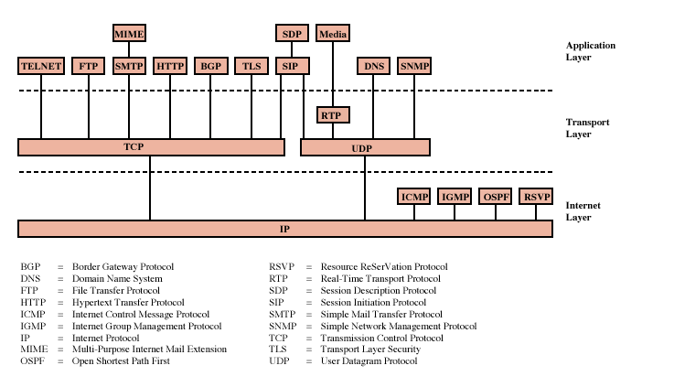
Protocols of TCP/IP Protocol Suite

Slide 9
Internet Protocol (IP)
IP provides connectionless (datagram) service
Each packet treated separately
Network layer protocol common to all routers
  which is the Internet Protocol (IP)
Connectionless Service??

Slide 10
Connectionless Internetworking (General)
Advantages
  Flexible and robust
    e.g. in case of congestion or node failure, packets find their way easier than connection-oriented services
  No unnecessary overhead for connection setup
  Can work with different network types
    does not demand too much services from the actual network
Disadvantage: Unreliable
  Not guaranteed delivery
  Not guaranteed order of delivery
    Packets can take different routes
  Reliability is responsibility of next layer up (e.g. TCP)

Slide 11
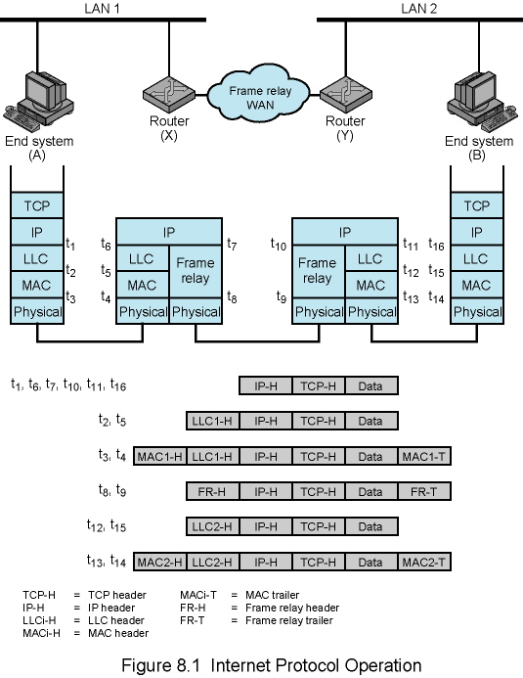
Example Internet Protocol Operation

Slide 12
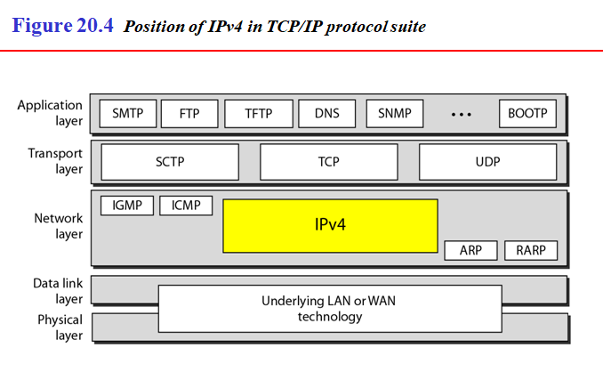
Internet Protocol (IP) Version 4

Slide 13
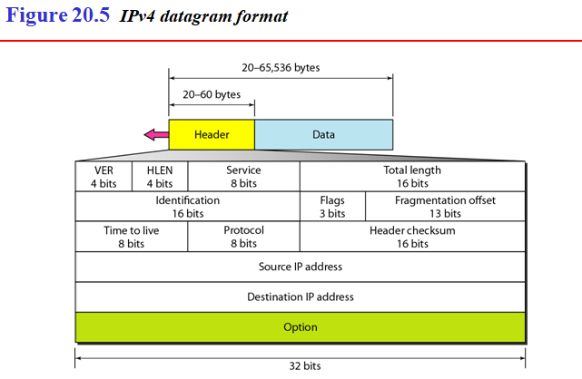
Header + Data using IPv4

Slide 14
Header + Data using IPv4
An IPv4 address is 32 bits long.
The IPv4 addresses are unique
and universal.
The address space of IPv4 is
2³² or 4,294,967,296.

Slide 15
Thank You
Discussion & Doubt session will be in lecture.
Important terms to keep in mind
  IP
  IPv4
  Forwarding and Routing

